Slide 1
European Research Consortium for Informatics and Mathematics
January 2025

Slide 2
Objectives (1)
Contributing to a leading role of Europe in ICT:
by building a European-wide, open network of centres of excellence in ICT.
by excelling in research and by acting as a bridge to applications.
by being internationally recognized as a major representative organisation in its field; the portal which gives access to all relevant ICT research groups in Europe.
Notes:
In every European country there should be one member institute, which serves …
It is our strong belief that all participants will benefit from cooperation
- By sharing knowledge
- By developing a shared vision on technological developments
- And by utilizing synergy
------------------
ERCIM fosters a shared view among its members which is based on the ambition to excel .... and to act as a bridge to
promote European applications

Slide 3
Objectives (2)
by acting as an interface for the non-EU member institutions within the European Community and other international organisations.
by cooperating with other international organisations in its field.
by promoting cooperation in research, technology transfer, innovation and training.
Thus creating added value for its members, for their countries and for Europe.
Notes:
... And other international organisations like NSF, ESF and W3C
----------------
MoU signed with ESF,
Had a joint ERCIM-ESF workshop to discuss important topics for research in ICT
Meetings with ESF and NSF
With all these objectives and actions to reach them, we think we as ERCIM create added value for our members

Slide 4
Organisational Structure
The ERCIM community is supported by a Consortium of two bodies:
ERCIM AISBL, an international non-profit association under Belgian law, carrying on the activities of ERCIM concerning collaborative research, networking, and support.
ERCIM EEIG, the European Economic Interest Grouping, the European Economic Interest Grouping, responsible for managing the ERCIM Office and hosting the W3C European Host.
Notes:
BoD: Policy and important decisions
XC: preparations of BoD meetings, carries out policy defined by BoD

Slide 5













Members
ERCIM is a consortium
of leading European research institutions
committed
to information
technology and
applied mathematics.

Slide 6
Members
Member Country
CNR Italy
CWI The Netherlands
Fraunhofer (ICT) Germany
FNR Luxembourg
FORTH (ICS) Greece
Inria France
INESC TEC Portugal
ISI Greece
ITIS-UMA Spain
NTNU Norway
RISE Sweden
SBA Austria
SZTAKI Hungary
UCY Cyprus
UWAW Poland
Size*
250
200
1750
150
200
1800
800
50
150
800
110
50
350
100
250
Member since
1991
1989 (founding member)
1989 (founding member, formerly GMD)
2002
2000
1989 (founding member)
2012
2008
2023
2002
1992
2013
1994
2011
2007
Members
of ERCIM EEIG
* estimated staff (FTE) in areas relevant to ERCIM

Slide 7
Members
New members welcome!
Benefits of ERCIM AISBL Membership
International Recognition
Esteemed as a leading ICT R&D centre within a European network of excellence.
Strategic Influence
Shape European and national ICT R&D policies through collaborative initiatives.
Exclusive Access
Engage with standardisation bodies like W3C, ETSI, and other strategic partners.
Opportunities to Participate
Join high-impact projects, committees, and boards influencing ICT strategy.
Extensive Networking
Connect with over 10,000 research professionals and establish valuable contacts at bi-annual meetings.
Professional Development & Visibility
Enhance staff growth through mobility programs and gain publicity via ERCIM’s platforms.

Slide 8
Management
ERCIM AISBL President
Björn Levin
RISE-SICS, Sweden
ERCIM EEIG President
Bruno Sportisse
President of Inria, France
ERCIM Office
Manager: Dominique Hazaël-Massieux

Slide 9
International Cooperation
ERCIM considers it a high priority to develop cooperation with scientists all over the world. ERCIM:
  Is the European partner of the World Wide Web Consortium
  participates in EU activities
  has established contacts/cooperation with
    Informatics Europe
    ACM Europe
    ETSI, the European Telecommunications Standards Institute
    European Science Foundation

Slide 10
Consultancy
With a pool of IT experts from many European institutes, ERCIM has carried out:
  Evaluations for the World Bank’s INFODEV Programme
  Promotion activity for the EU IST Programme in Latin America
  Organization of strategic workshops
  Studies for the EC
  Consultancy in research project management.

Slide 11

ERCIM, the European Partner of W3C
ERCIM EEIG hosted the European headquarters of W3C in January 2003
Two of the European Chapters are currently based at ERCIM institutes, namely at FORTH (Greece) and SZTAKI (Hungary).
Originally, W3C Offices were located at the ERCIM institutes CWI, Fraunhofer-Gesellschaft, FORTH, SZTAKI, CNR, RISE/SICS and STFC).
Notes:
Change from INRIA to ERCIM due to 2 main reasons:
contractual problems at INRIA (short term contracts expire)
Need to strengthen research relationships throughout Europe
to better support web technology development
----------
Possibility to have more European influence in the technical development of new standards for the web
---------
INRIA well-known for incubating new initiatives as they did originally as host for W3C.
Now the opportunity to expand into a new phase -> Logical step to put the European participation in W3C
on a broader basis by shifting the host from INRIA to ERCIM
--------
CWI (Benelux), FhG IMK (Germany & Austria), FORTH (Greece), SZTAKI (Hungary), CNR (Italy), SICS (Sweden), CLRC (UK & Ireland)
Offices work with W3C hosts promoting local languages, broadening W3C‘s geographical base, and encouraging international participation in W3C activities.

Slide 12
Present Links with W3C
ERCIM members involved in Internet/Web research
Participation in W3C working groups
Three ERCIM members host W3C Chapters
Joint participation in EU projects.
Potential for the Future
ERCIM: research in Web technologies
W3C: technology transfer and Web standards adoption by EU industry
Broader base in Europe for W3C
Increased European participation in Web standardisation
W3C – ERCIM joint Horizon Europe projects.

Slide 13
Science coordination
Research Projects
ERCIM participates in research projects
as coordinator or partner
Scientific activities: carried out by ERCIM members
Administrative tasks: carried out by the ERCIM office.
Through ERCIM, our member institutes have participated in more than 120 EU-funded projects

Slide 14
Science coordination
Research Projects
Current/recent projects include:
NEPHELE - Future European platforms for the Edge -A lightweight software stack and synergetic meta-orchestration framework for the next generation compute continuum
SMARTEDGE - Semantic Low-code Programming Tools for Edge Intelligence
GLACIATION – Using emerging digital technologies to provide services for green and privacy preserving data operations across the edge-to-cloud architecture.
See https://www.ercim.eu/activity/projects

Slide 15
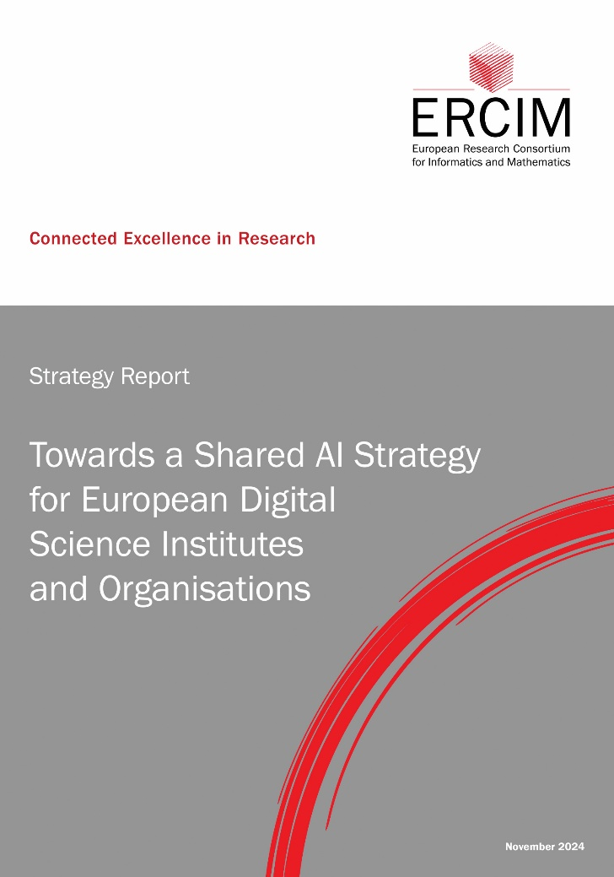
Science coordination
Visionary events and strategic report
Latest report:
Towards a Shared AI Strategy for European Digital Science Institutes and Organisations

Slide 16
Science coordination
Working Groups
Organise workshops
Prepare common projects
Receive fellows from ERCIM’s fellowship programme
Are entitled to financial support
Computational and Methodological Statistics
Dependable Software-Intensive Embedded Systems
Ethics – Beyond Compliance
Formal Methods for Industrial Critical Systems
Image and Video Understanding (MUSCLE)
Security and Trust Management

Slide 17
Science coordination
Expert Groups
Are established on the initiative of the ERCIM Board to investigate current topics
Limited period
Produce strategic papers to coordinate relevant activities of common interest
Receive financial support
Big Data
Security and Privacy
Open Access
AI

Slide 18
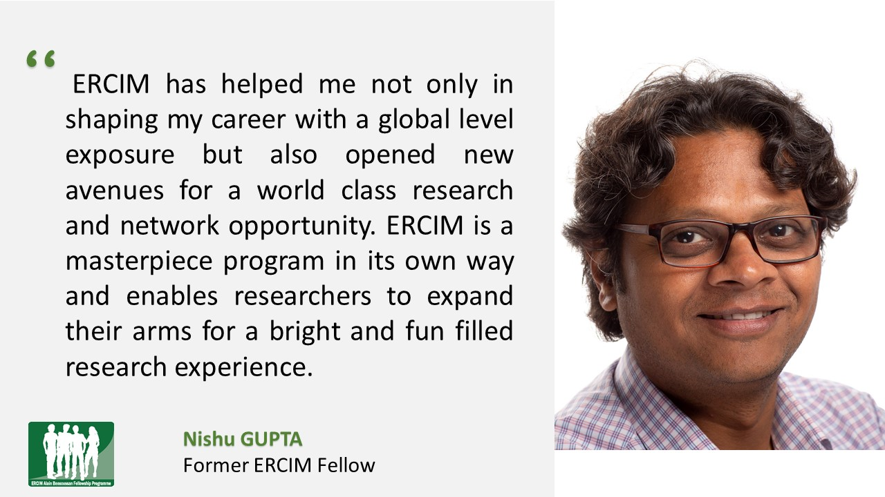
Human Capital
Postdoctoral Fellowship Programme
Open to PhDs, world-wide
Over 750 fellowships awarded since 1990
12 months duration at an ERCIM institute (with possible extension)
Includes exchange programme for a short
visit in a second ERCIM
institute (Research Exchange Programme)
Competitive salary

Slide 19
Human Capital
Cor Baayen Award
Cor Baayen Young Researcher Award
  awarded every year to a promising young researcher in computer science and applied mathematics.
  created in 1995 to honour the first ERCIM President.
  consists of a cheque for 5000 Euro together with an award certificate.
  Latest Winners:
  2024: Nicola Messina
  2023: Rianne de Heide
  2022: Fabio Carrara
  2021: Tomasz Kociumaka
  See: https://www.ercim.eu/human-capital/cor-baayen-award

Slide 20




Outreach
ERCIM News
Quarterly magazine
Free subscription
Published in print and online
Referenced by dblp
Each issue features a special theme
About 120 articles published per year
See: https://ercim-news.ercim.eu

Slide 21
Further information
ERCIM Office
BP 93
F-06904 Sophia Antipolis
+33 4 92 38 50 10
contact@ercim.eu
www.ercim.eu

